Slide 1
System Verification and Validation (VnV) Plan for Bridging Gaps: AI for Diagram Accessibility
Team 22, Reading4All

Slide 2
Brief Overview:
Goal for a VnV Plan
Out of Scope
Challenge Level & Extras
Verification and Validation Roles
System Tests – Example
Upcoming Deadlines

Slide 3
Goal of a VnV Plan:
“Build the right system, build the system right”
Verify accuracy, accessibility, and usability of the Reading4All system.
Validate alt text is contextually correct and comprehensive.
Ensure interface accessibility for all users
  Especially those using screen readers or assistive technologies
Confirm secondary features (editing, history, downloads) function properly.

Slide 4
Out of Scope for a VnV Plan:
Assume the following tools are stable:
External libraries (PyTorch, TensorFlow, etc.)
McMaster SSO authentication (handled by university)

Slide 5
Challenge Level & Extras
Level: General
Extras:
  Norman’s Principles Report – evaluates usability & accessibility design.
  User Manual – comprehensive guide for end users.

Slide 6
V&V Team Roles
Member | Focus Area | Responsibilities
Moly & Fiza | Functional Requirements | Verify & manually test core features
Nawaal | User Testing Lead | Plan & execute user sessions
Casey | Usability Lead | Validate WCAG 2.1 & usability
Dhruv | Performance & Environment | Test performance & reliability
All Team Members | Look & Feel | Validate design consistency
Ms. Jing Sui | Supervisor | Review usability & alt text quality

Slide 7
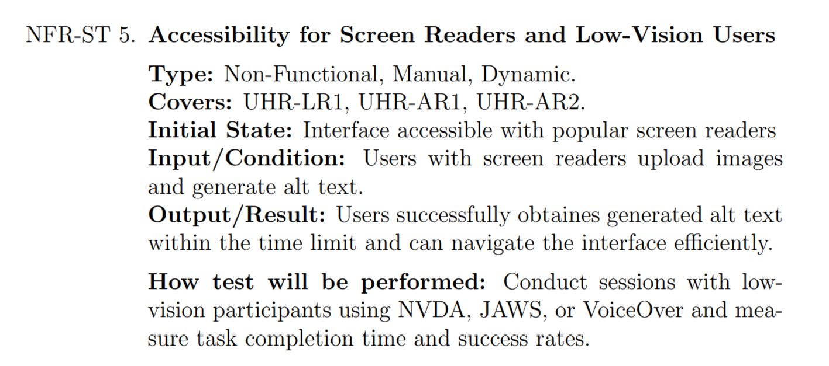
Example of a System Test

Slide 8
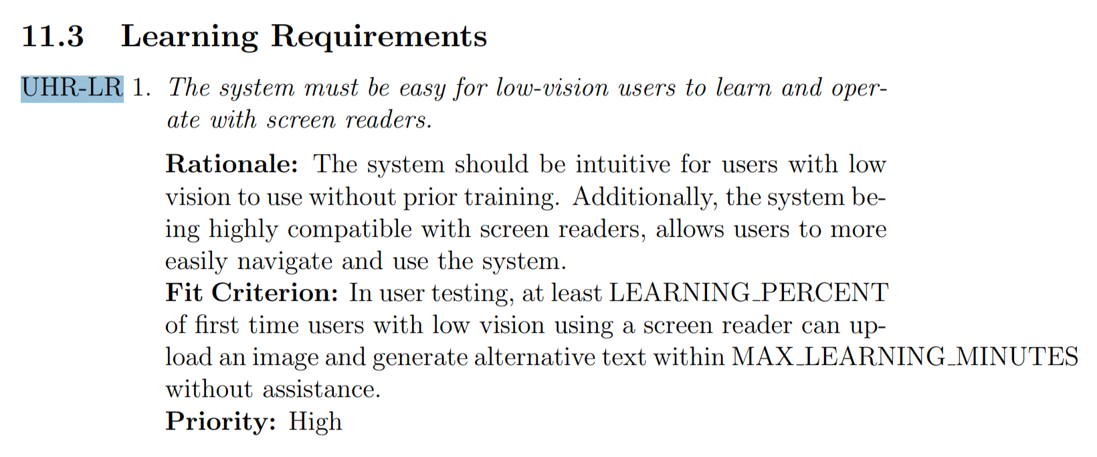
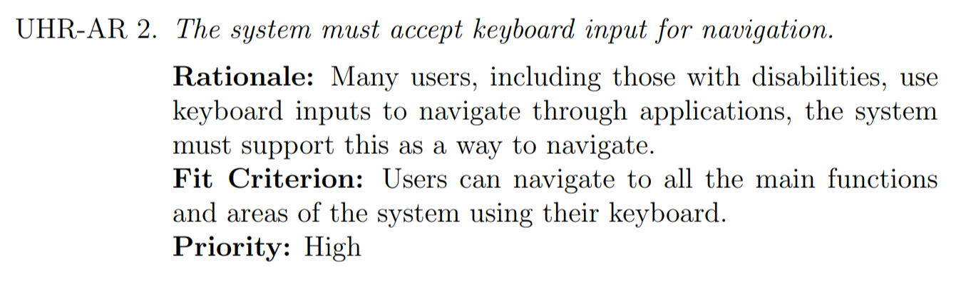
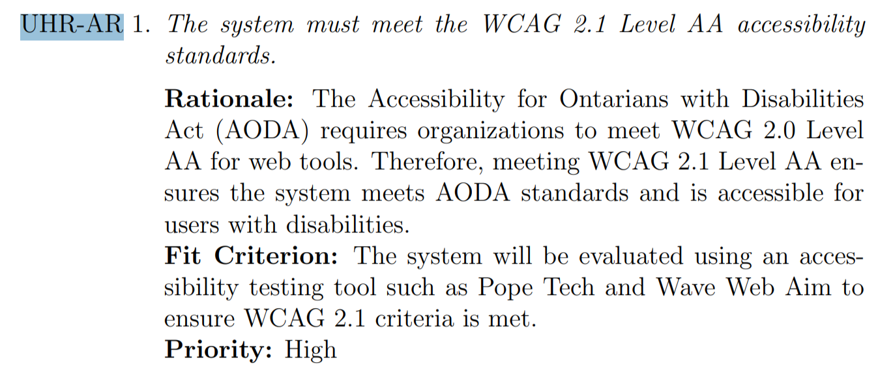
Specific References from SRS

Slide 9
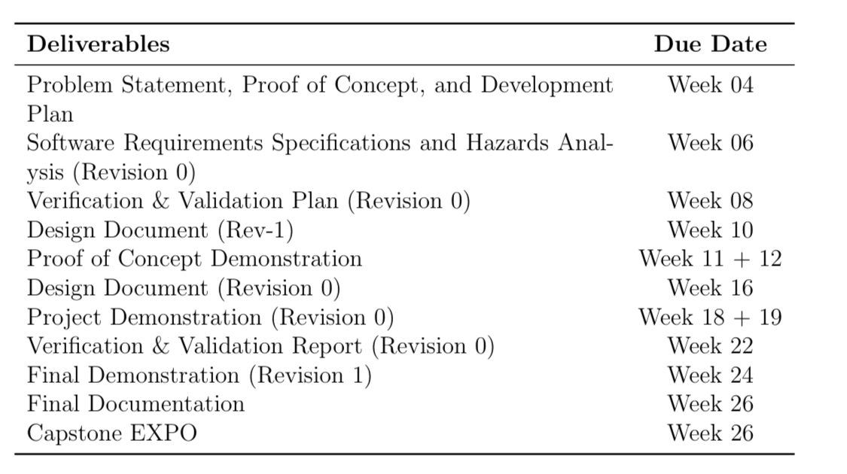

Upcoming Deadlines
Working in parallel for now

Slide 10
Thank you for listening!

